Slide 1
Home About Services Workers Contact Us

Slide 2
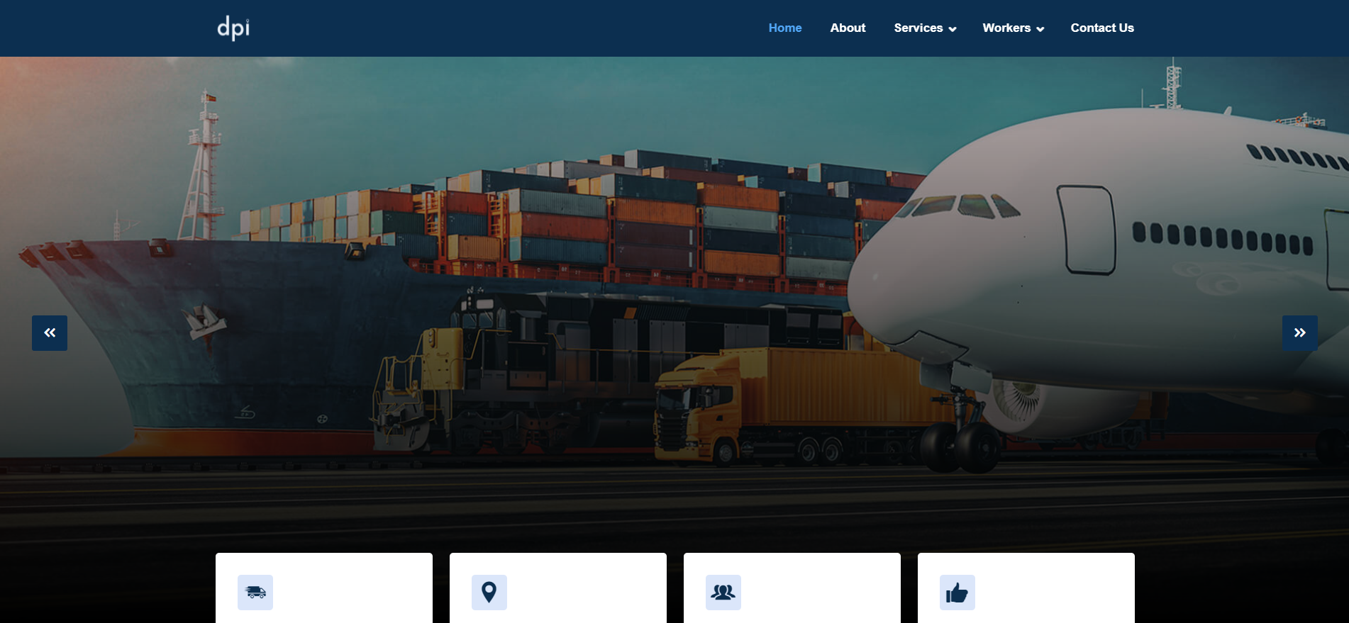
AIR FREIGHT
When time and speed are key We are here to provide you with the best service as the general agent for over 22 international airlines, handling cargo for more than 300 flights per week.
Get a Free Call
Get A Free Call
Send us inquiry

Slide 3
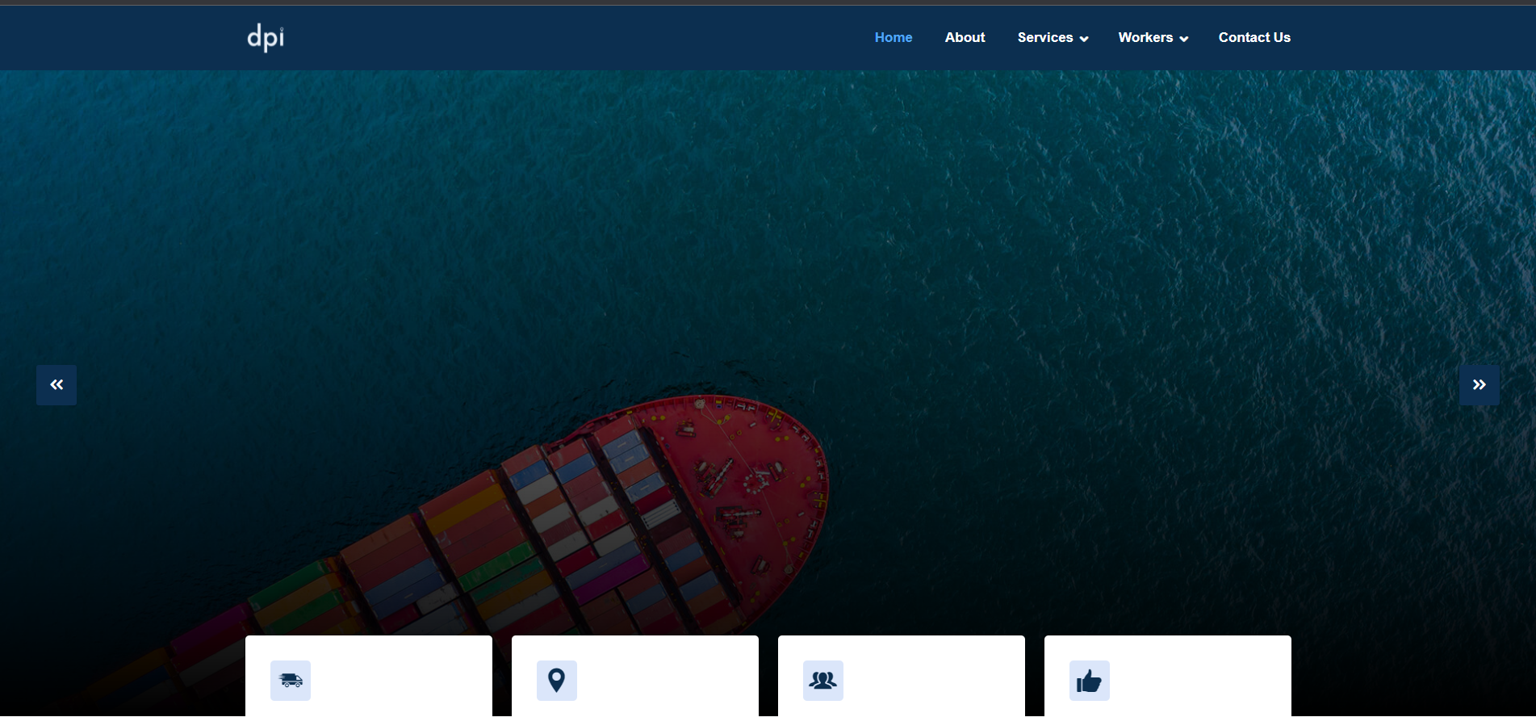
OCEAN FREIGHT
With our ever-expanding network, we transport an average of 2000 containers per month, affirming our leading position in ocean freight.

Slide 4




48,869 KM
Total Delivered
120
Countries Delivered
3.4K Customers Served
10 Years Experience

Slide 5

About Us
Provide The Best Logistics Solutions For You
About Our Mission
DPI Global Logistics is a fast-growing, dynamic and new age company that specializes in providing comprehensive logistics services & solutions through land transport, worldwide air and ocean freight, to importers and exporters alike. Founded by an industry-veteran with more than 10 years of experience & expertise in the trade, DPI Global Logistics continuously strives to extend quality services in a cost-effective and time-bound manner.
We acknowledge that your shipment is not only cargo but also your reputation to your esteemed customers. Therefore, we always keep in our mind that your reputation is our reputation. Day or night, holidays or working days, we are always ready for your calls to care your cargo.
In short, we live up to our promise “Fast, Safe, Effective and Competitive Price” – We provide you a “Your integrated logistics solution”.
About Us DPI Global Logistics is a fast-growing, dynamic and new age company that specializes in providing comprehensive logistics services & solutions through land transport, worldwide air and ocean freight, to importers and exporters alike. Founded by an industry-veteran with more than 10 years of experience & expertise in the trade, DPI Global Logistics continuously strives to extend quality services in a cost-effective and time-bound manner.
We acknowledge that your shipment is not only cargo but also your reputation to your esteemed customers. Therefore, we always keep in our mind that your reputation is our reputation. Day or night, holidays or working days, we are always ready for your calls to care your cargo.
In short, we live up to our promise “Fast, Safe, Effective and Competitive Price” – We provide you a “Your integrated logistics solution”.
Misson: Providing leading domestic and international freight forwarding and transportation services.
Mission on community and society.
Create material and spiritual values for shareholders and employees

Slide 6
ABOUT US
DPI Global Logistics is a fast-growing, dynamic and new age company that specializes in providing comprehensive logistics services & solutions through land transport, worldwide air and ocean freight, to importers and exporters alike. Founded by an industry-veteran with more than 10 years of experience & expertise in the trade, DPI Global Logistics continuously strives to extend quality services in a cost-effective and time-bound manner.
We acknowledge that your shipment is not only cargo but also your reputation to your esteemed customers. Therefore, we always keep in our mind that your reputation is our reputation. Day or night, holidays or working days, we are always ready for your calls to care your cargo.
In short, we live up to our promise “Fast, Safe, Effective and Competitive Price” – We provide you a “Your integrated logistics solution”.
OUR VISION
To become a leading company in forwarding and transporting goods in Vietnam as well as in the world through the most professional and prestigious solutions.
OUR MISSION
Providing leading domestic and international freight forwarding and transportation services.
Mission on community and society.
Create material and spiritual values for shareholders and employees

Slide 7
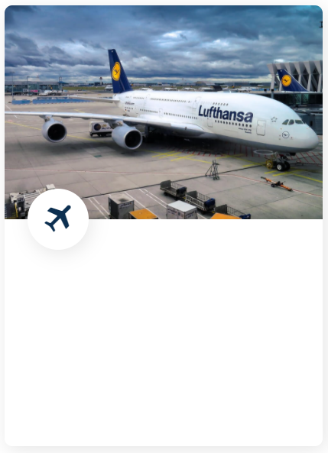

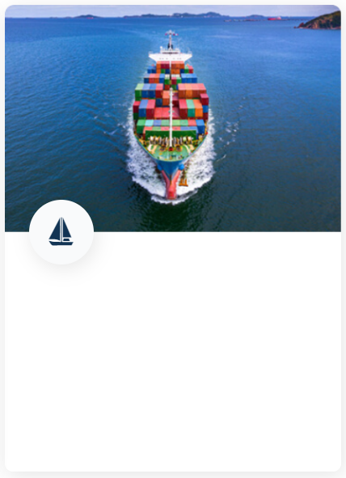
OUR SERVICES
Air Freight
Road Freight
Ocean Freight
When time and speed are KEY
Domestic, international and long distance
When the volume of goods is large and the cost is important
Read More
Read More
Read More

Slide 8
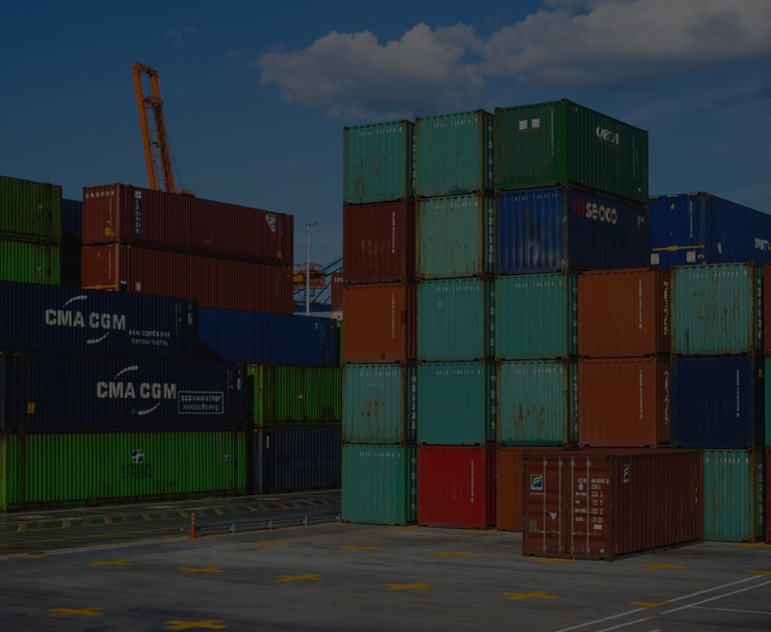
^{Why People Choose DPIG}
Our experienced professionals are trained to handle the complexities of moving your freight around the world, so you can focus on what matters: growing your bottom line.
1. OUR TEAM
The staffS at DPIG Logistics are professional, enthusiastic and knowledgeable. They understand the service customers need.
2. ALWAYS SAFE
Giving you the security that your shipment will reach the destination safely and on time.
3. COMPETITIVE PRICES
DPIG Logistics always get the best way for shipping cargos door to door for saving cost and delivery safely.
4. ALWAYS AVAILABLE 24/7
We are always ready for your calls to care your cargo whenever you need. 5. PERFECT SOLUTIONS
Providing specialized solutions for each customer and consulting tailor made logistics solutions for each business.

Slide 9

^{Workers}
^{Our Valuable Workers}
John Doe
Naimuk Waninolin
Mark Tyson
Jackson
Air Freight Collector
Road Freight Collector
Road Freight Collector
Road Freight Collector

Slide 10




^{Feedbacks}
^{Feedback From Our Clients}
Thank you for your continued partnership throughout this year. It has been a challenging year and will be challenging moving forward. We greatly appreciate your team. Their fast and friendly service is a rare gem in the supply chain world right now!
DPI Global team is amazing. Professional, timely, communicative. They work seamlessly and when troubleshooting is needed, they always find the right solution.
^{Feedbacks}
^{Feedbacks}
Bryan Schneider
Kelli McCann

Slide 11






Slide 12






Our Services
Our Supports
Quick Links
0979 359 600
Sales@dpig-logistics.com
No. 10a, Group 1, Viet Hung Ward, Long Bien District, Hanoi City, Vietnam
Privacy & Policy
FAQS
Terms & Conditions
Contact Us
About Us
Home
Abouts
Our Services
SEARFREIGHT AIRFREIGHT
ROADFREIGHT

